Slide 1








The Spectral Information System SPECCHIO V3.3 - Introduction
Andy Hueni¹
¹ Remote Sensing Laboratories, University of Zurich, Switzerland
Date: 2024 APR

Slide 2
Agenda
Spectral Information Systems: Raison d'être
Metadata
Methods
SPECCHIO Architecture
Spectroscopy Lifecycle Support
Results

Slide 3

Spectral Information Systems: Raison d'être
Where the heck are my spectra I collected just last summer?
Spectral Information Systems are systems for building and providing spectral information, utilising spectral databases as repositories for spectral data and associated metadata.
http://phdcomics.com

Slide 4

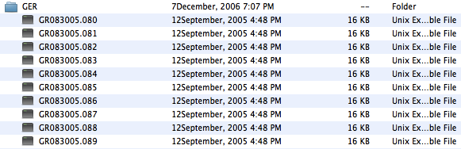
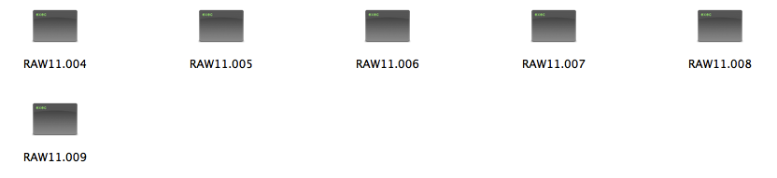
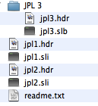
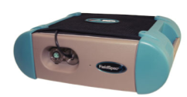
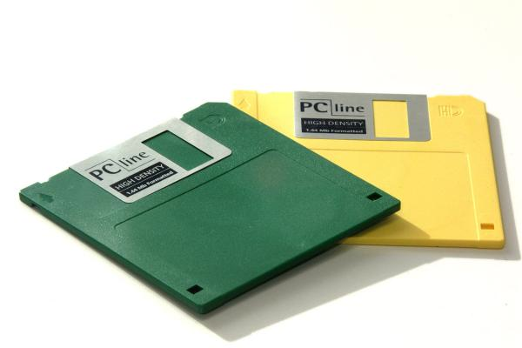
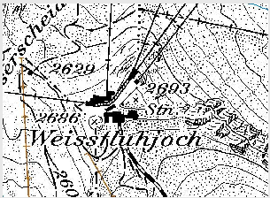

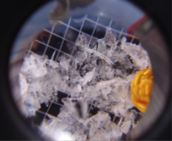
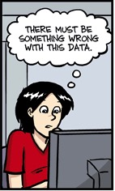
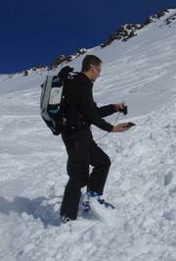
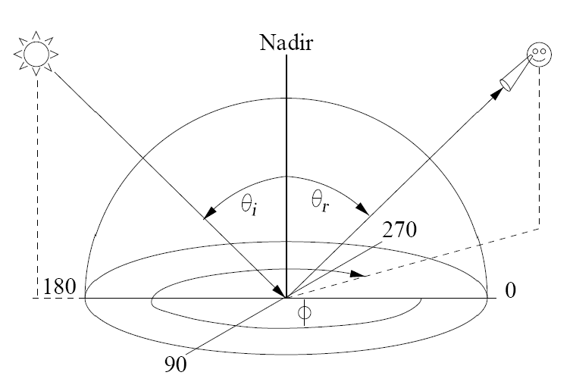


Common Issues in Field Spectroscopy
Where are my data files?
My instrument is not producing the truth?!?
... and there are thousands of them: how to keep track?
Can someone else make use of my data?
What were the sampling context and conditions?
http://phdcomics.com

Slide 5
On the Importance of Metadata
W. K. Michener, J. W. Brunt, J. J. Helly, T. B. Kirchner, and S. G. Stafford, "NONGEOSPATIAL METADATA FOR THE ECOLOGICAL SCIENCES," Ecological Applications, vol. 7, pp. 330–342, 1997.

Slide 6
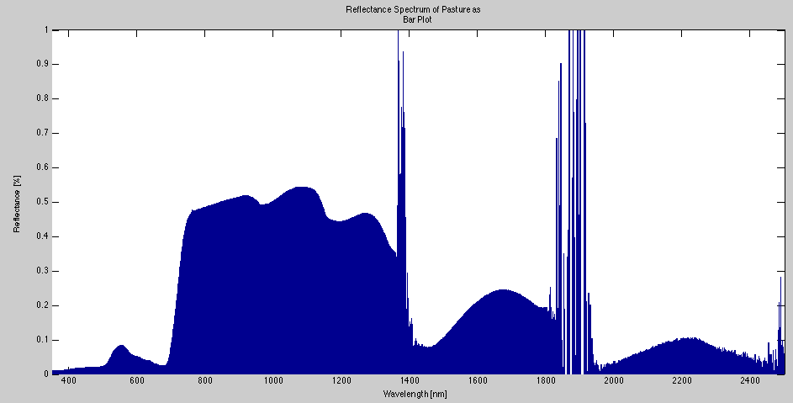
SPECCHIO Spectral Information System
Methods
Metadata = Contextual Awareness

Slide 7

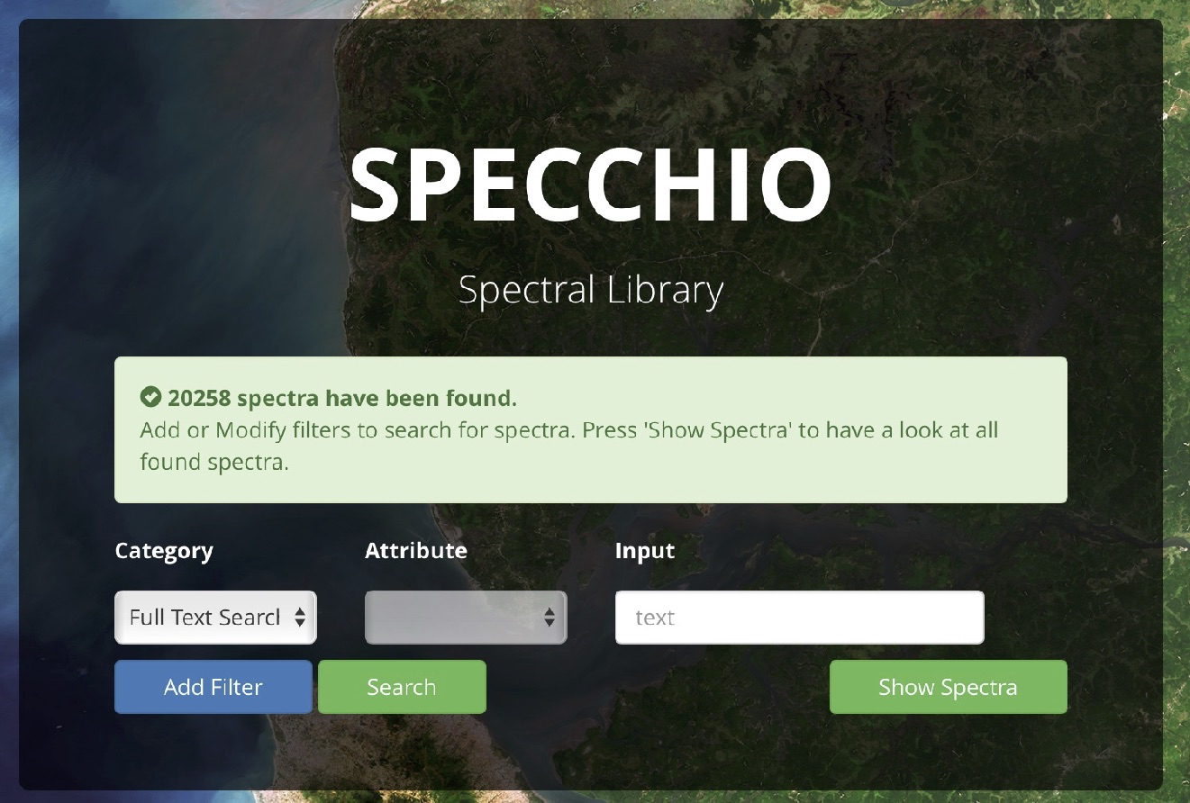








Architecture – V3
User Workstation
Web Browser Interface
SPECCHIO Server
Glassfish Application Server
& Web Server
MySQL Database Server
HTTPS Port
Port 3306
Java VM (JRE 1.6)
SPECCHIO
DB
SPECCHIO App
Pure Java
SPECCHIO API
Higher Level Languages
Relational storage of spectral data and metadata
Data sharing / Multiuser / Research Groups
Open source/access components
App
with SPECCHIO
Java
components

Slide 8
Spectroscopy Lifecycle Support
Search by adding metadata constraints
Experimental Planning
Data Acquisition
Data
Ingestion
Metadata Augmentation
Data Processing
Information Retrieval
SPECCHIO
Spectral
Information
System
Automation, because data entry is tedious!
Allow processing without data export to files. Keep provenance information.
Add metadata to spectral data in a smart way (group updates for redundant data!)

Slide 9
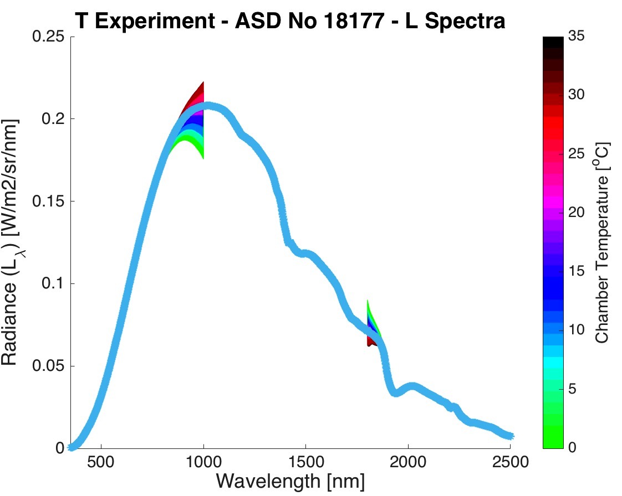
Spend your research time analysing data instead of trying to find it on your file system.
Data Search: SPECCHIO GUI & Matlab/R work well in concert or stand-alone
Meta
Files
Data Augmentation and processing: add metadata to spectra and apply spectral processing.
Spectral
Files
Data Analysis: easiest in Matlab/R
Select&Search
Insert
Select/Insert
Data ingest:
Either via SPECCHIO GUI,
or if no reader exists, use our own implementation in Matlab or R
SPECCHIO Server
SPECCHIO
DB

Slide 10



Results
Practical Use
Installation/Availability
Experimental Planning
Data Acquisition
Data
Ingestion
Metadata Augmentation
Data Processing
Information Retrieval
SPECCHIO
Spectral
Information
System

Slide 11
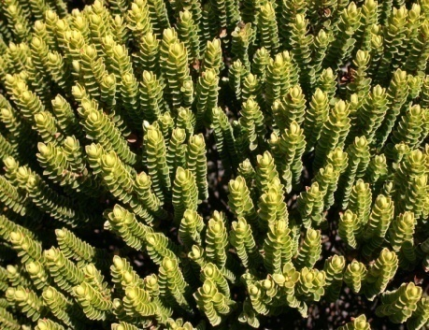
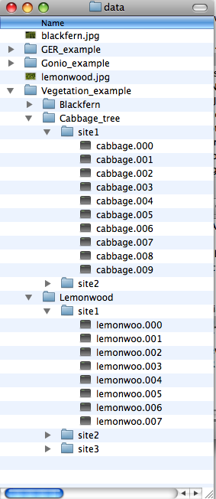
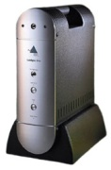
Concepts - Data Input
Experimental Planning
Data Acquisition
Data
Ingestion
Metadata Augmentation
Data Processing
Information Retrieval
SPECCHIO
Spectral
Information
System
Intelligent
data input
process
Automatically extracted metadata
Spectral data
SPECCHIO
Spectral
Database
Spectral files
&
user defined structures
File system
Notes:
The first concept we are looking at is the data input.
This is a typical dataflow, where an object is sampled in the field using a spectroradiometer, generating spectral files. These spectral files are stored in user defined structures on the file system.
We then use an intelligent data input processes to read the spectral information and automatically extract metadata and insert these data into the database.

Slide 12
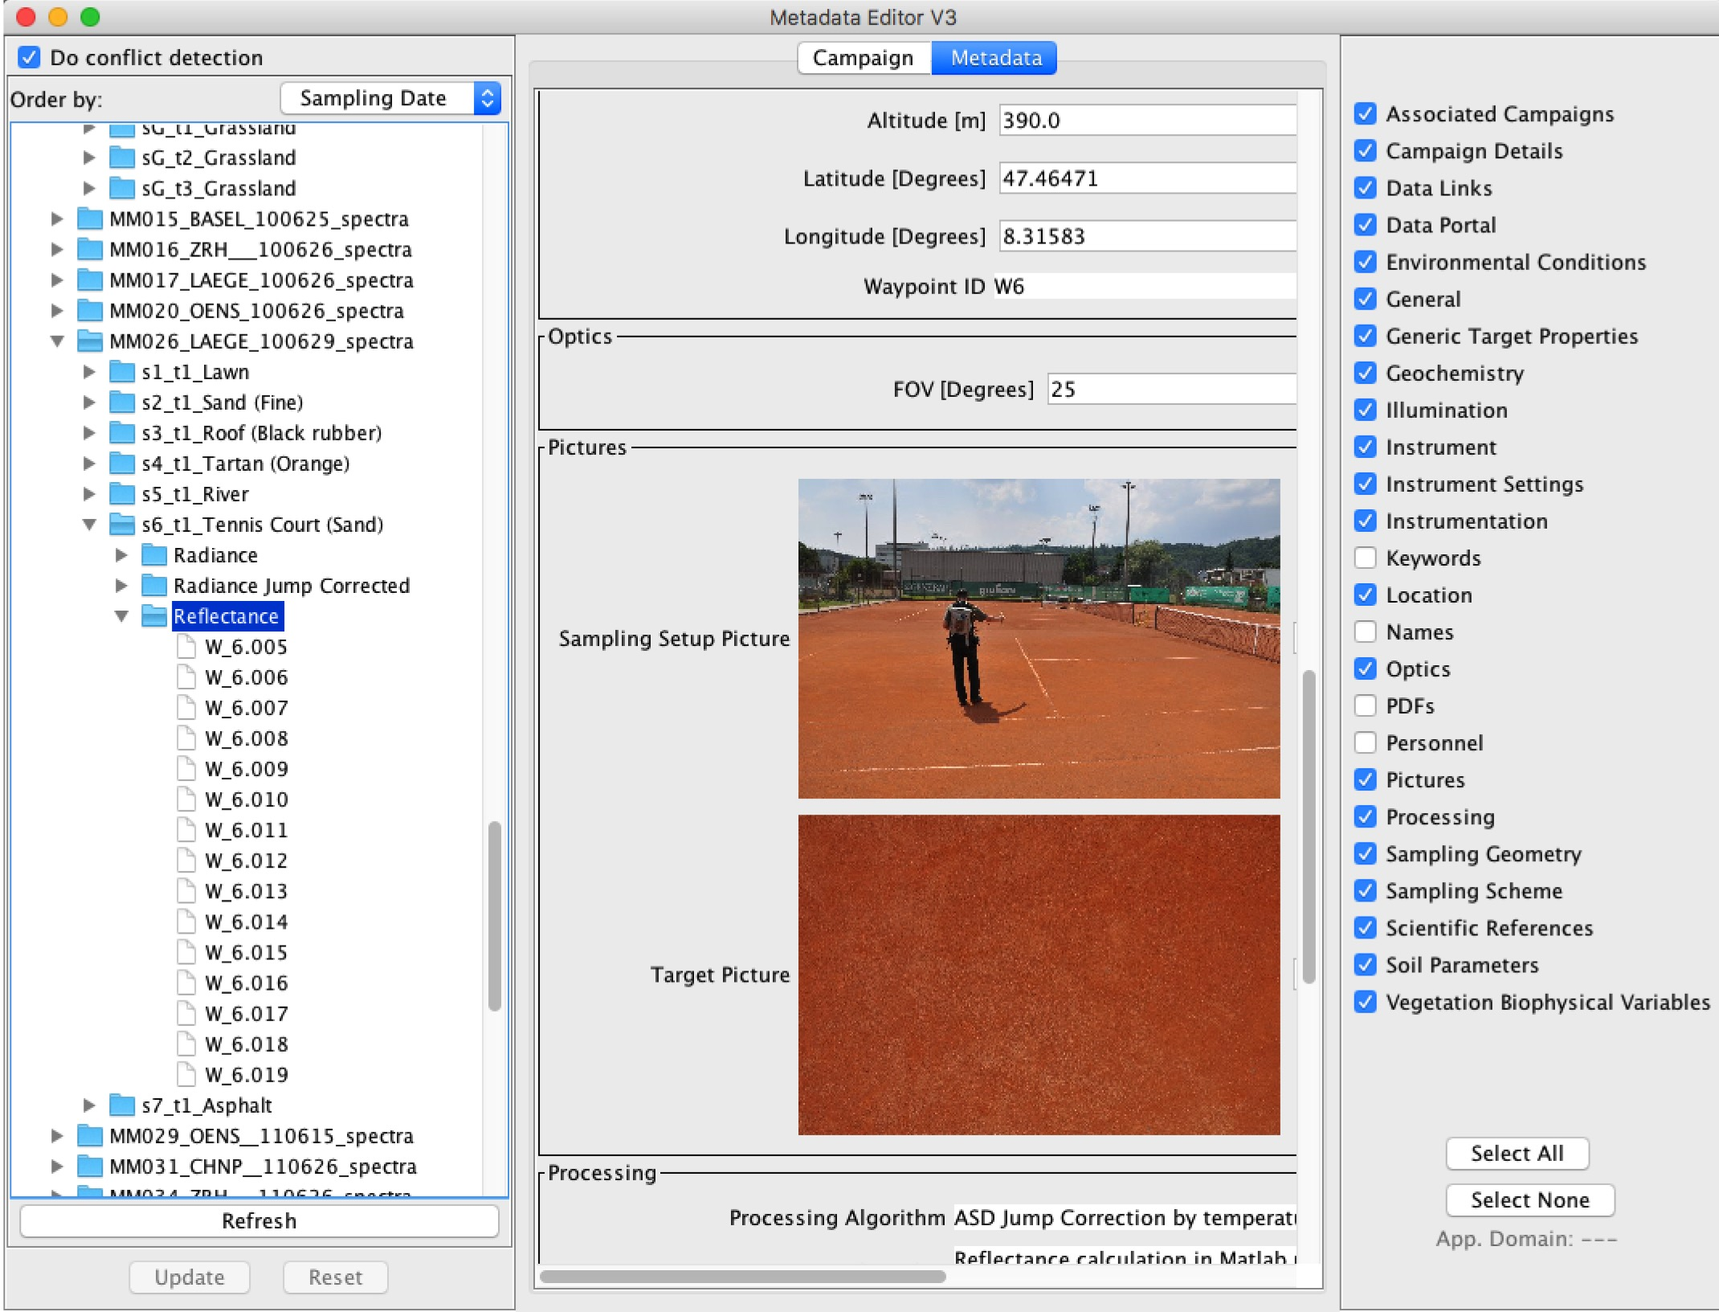
Metadata Augmentation
Experimental Planning
Data Acquisition
Data
Ingestion
Metadata Augmentation
Data Processing
Information Retrieval
SPECCHIO
Spectral
Information
System
Group updates
Conflict detection
Application domain categories
Automatic inserts:
Altitude
Measurement support
Solar angles
Goniometer Angles

Slide 13
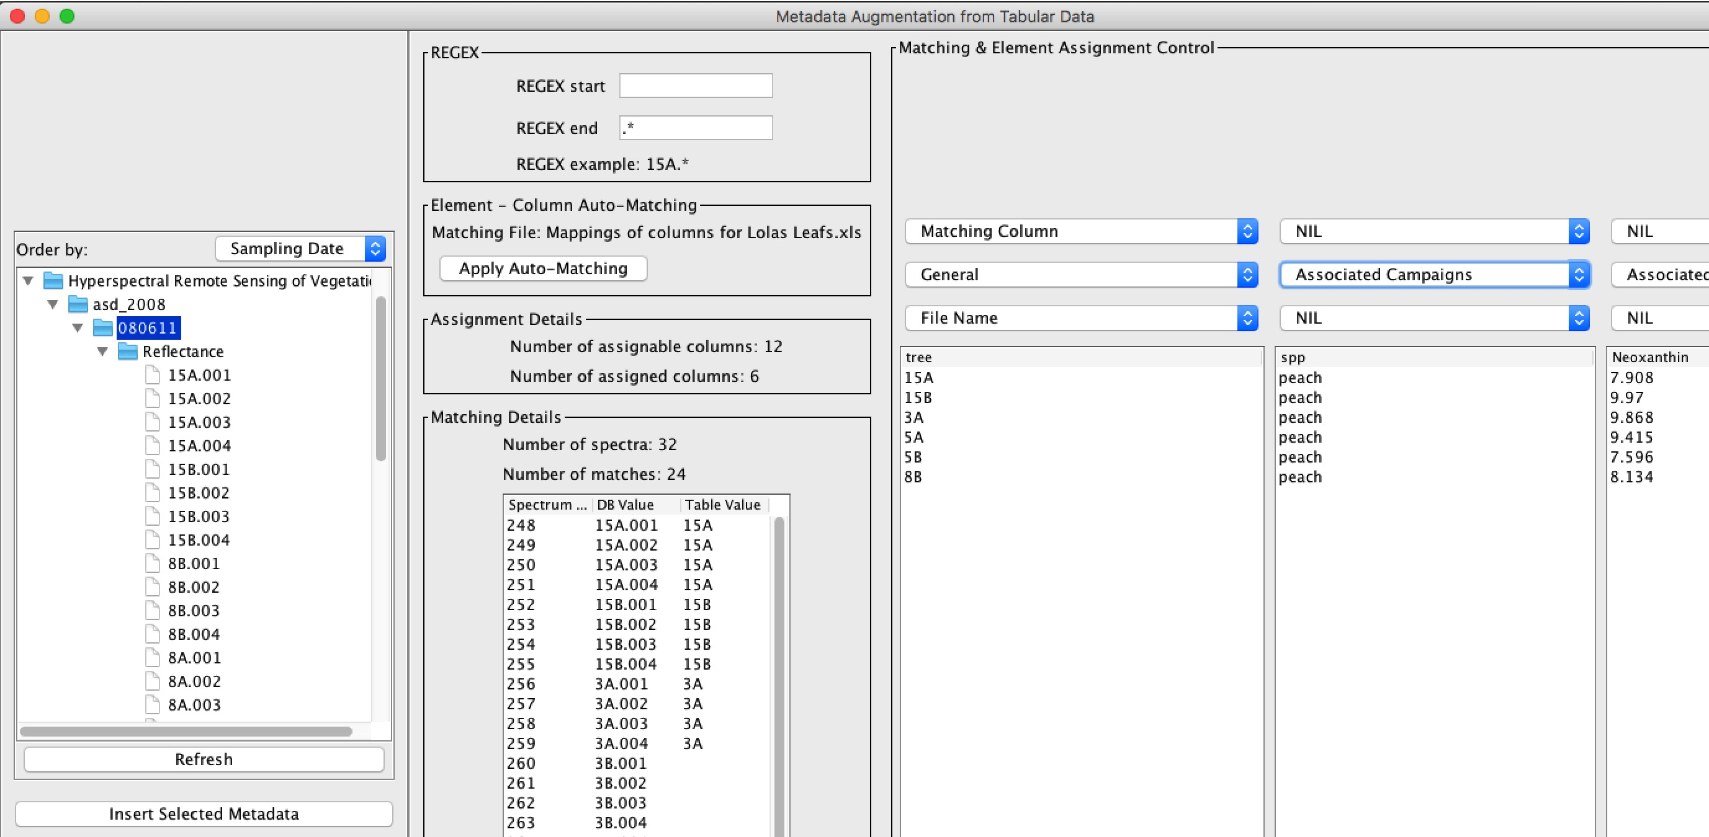
Metadata Augmentation from XLS
Experimental Planning
Data Acquisition
Data
Ingestion
Metadata Augmentation
Data Processing
Information Retrieval
SPECCHIO
Spectral
Information
System
Auto-matching to existing metadata in DB

Slide 14
Even with Automation, Metadata Entry takes Time!
Careful data curation effort, involving manual labour
Standard input with majority of metadata only read from spectrometer file.

Slide 15
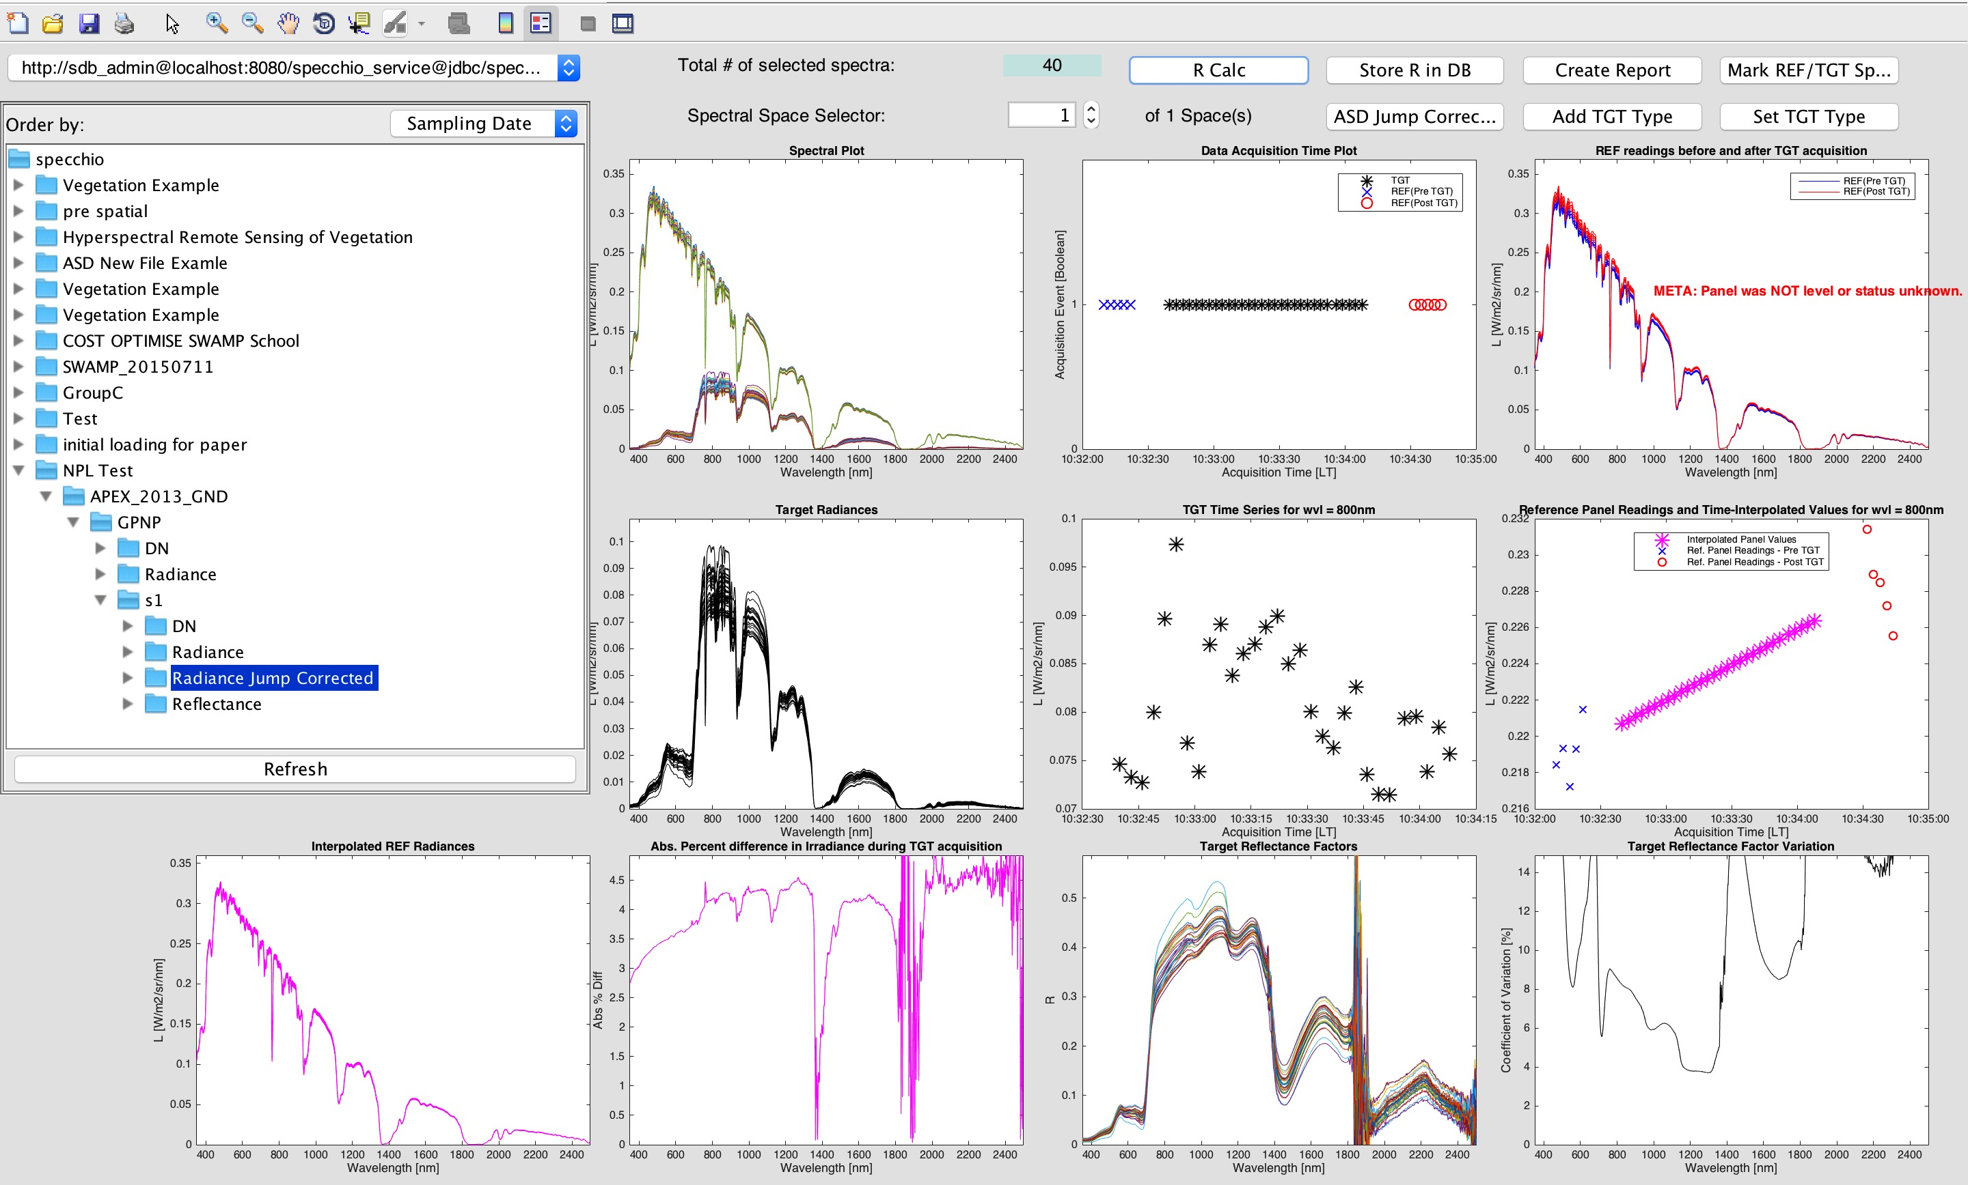
Spectral Processing: Reflectance Calculation
Experimental Planning
Data Acquisition
Data
Ingestion
Metadata Augmentation
Data Processing
Information Retrieval
Interactive processing: jump-corrected radiances to reflectance factors using linear irradiance estimation. Reflectance factors are inserted into the SPECCHIO database, linking with all previously entered metadata
SPECCHIO
Spectral
Information
System

Slide 16
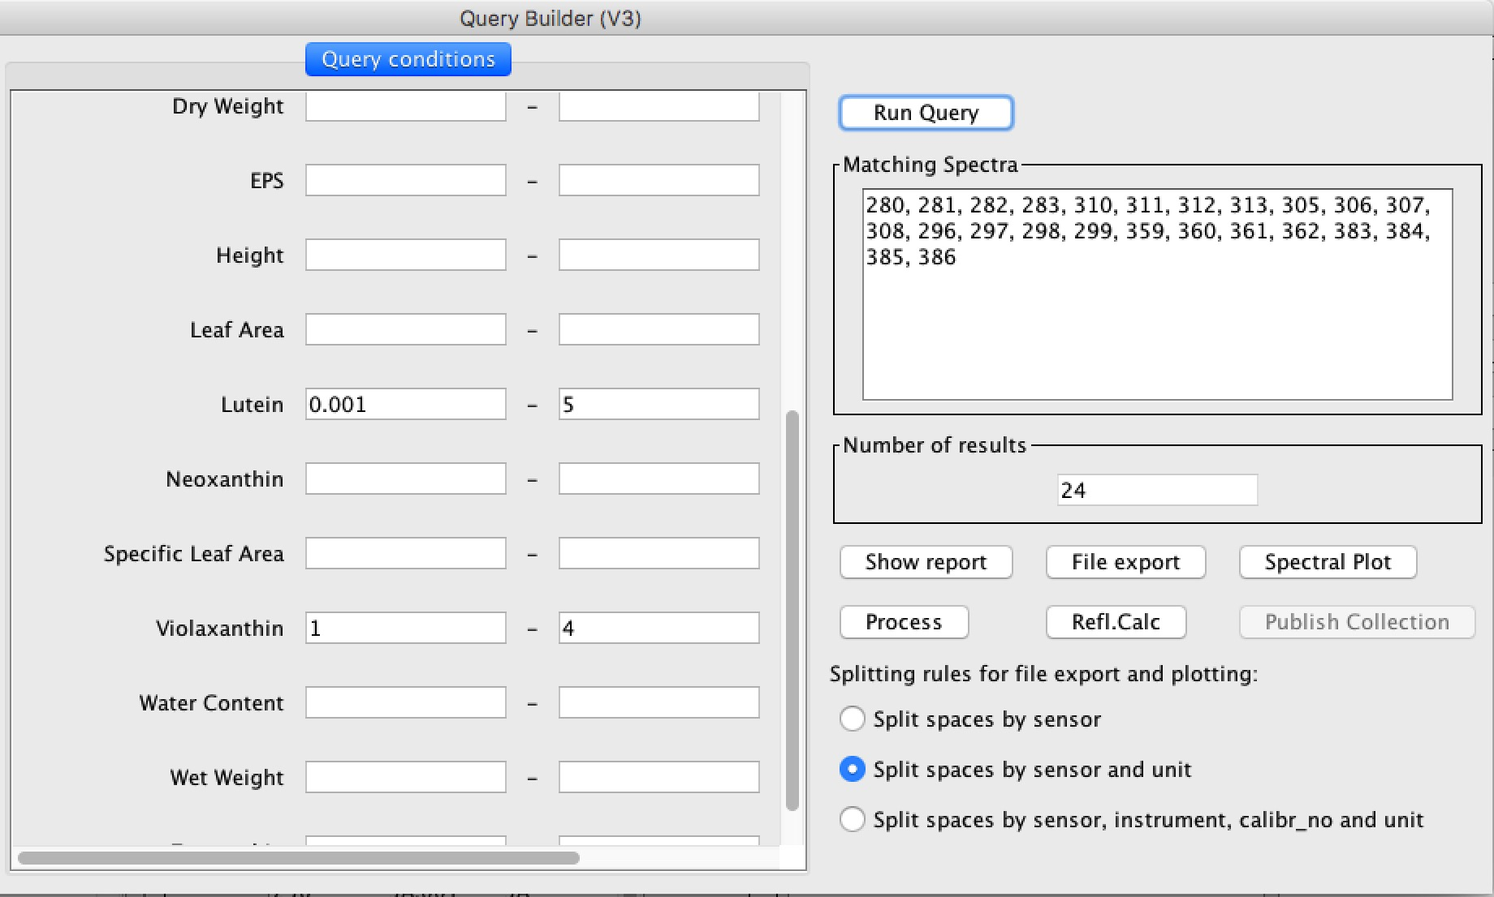
Data Selection
Experimental Planning
Data Acquisition
Data
Ingestion
Metadata Augmentation
Data Processing
Information Retrieval
SPECCHIO
Spectral
Information
System
Interactive Query Building
Metadata space restrictions
cond = EAVQueryConditionObject('eav', 'spectrum_x_eav', 'Lutein', 'double_val');
cond.setValue('0.001');
cond.setOperator('>=');
query.add_condition(cond);
cond = EAVQueryConditionObject('eav', 'spectrum_x_eav', 'Lutein', 'double_val');
cond.setValue('5.0');
cond.setOperator('<=');
query.add_condition(cond);
cond = EAVQueryConditionObject('eav', 'spectrum_x_eav', 'Violaxanthin', 'double_val');
cond.setValue('1.0');
cond.setOperator('>=');
query.add_condition(cond);
cond = EAVQueryConditionObject('eav', 'spectrum_x_eav', 'Violaxanthin', 'double_val');
cond.setValue('4.0');
cond.setOperator('<=');
query.add_condition(cond);
Autogenerated query code, for use in Matlab or R:

Slide 17
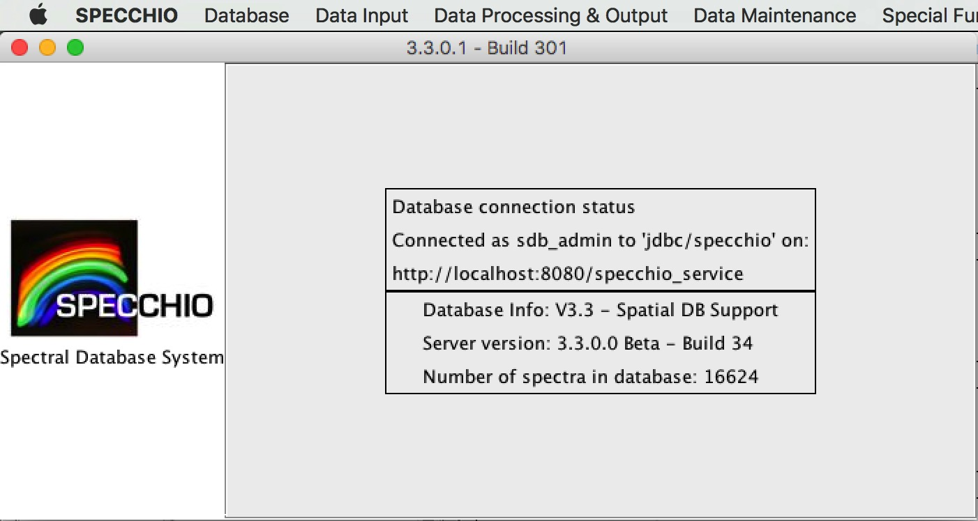
Availability and Installation: Online System
SPECCHIO Server
Glassfish Application Server
& Web Server
MySQL Database Server
HTTPS Port
Port 3306
SPECCHIO
DB
Web Interface
Online multiuser DB for data sharing and testing of the system.
OPTIMISE Training School data are available online
Java Client

Slide 18
Availability and Installation: Desktop Client
Java
Runs on macOS, Linux, Windows, etc
GUI
Connection to any open access SPECCHIO database

Slide 19
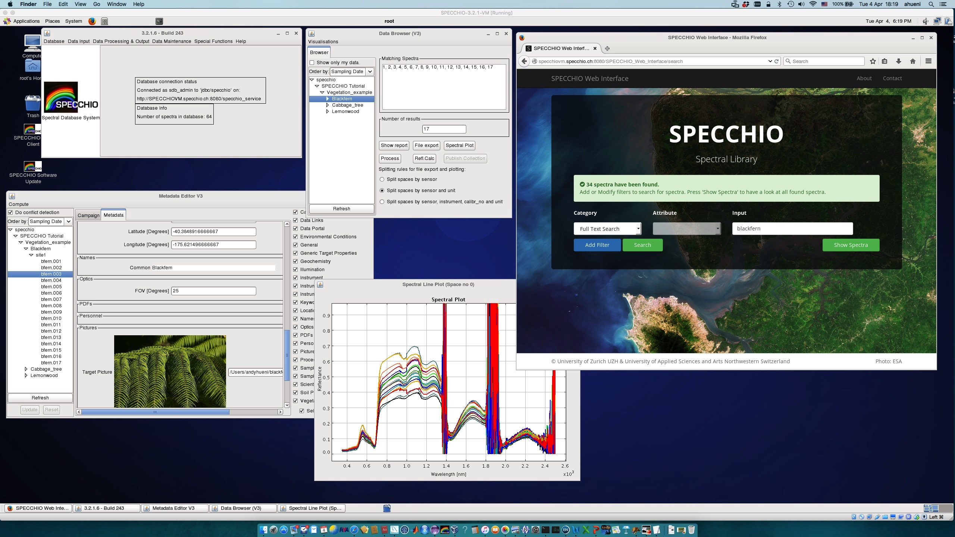
Availability and Installation: SPECCHIO Virtual Machine

Slide 20
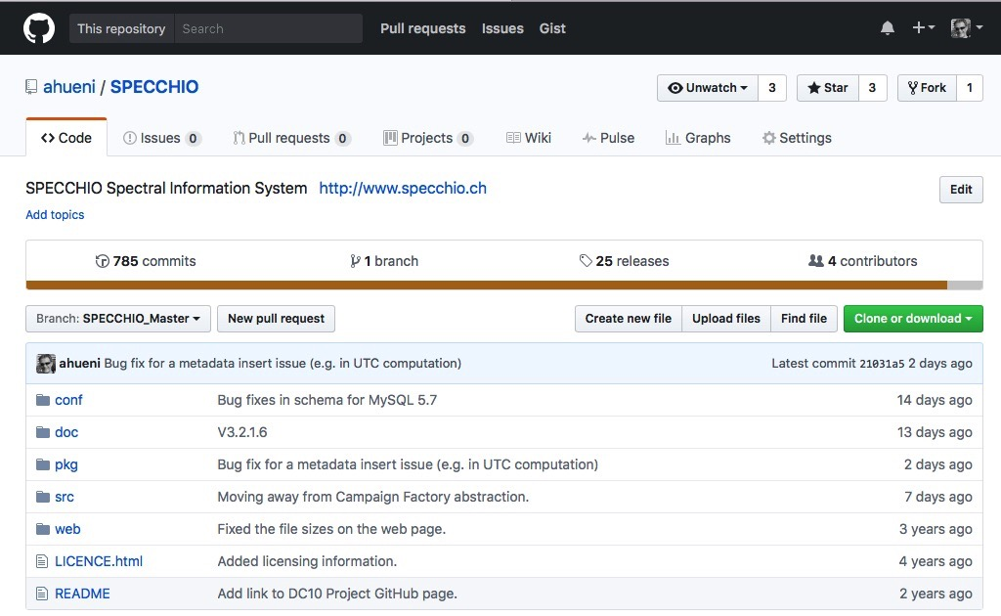
Availability and Installation: Open Source
All SPECCHIO code (client and server) is open source and can be found on GitHub: https://github.com/SPECCHIODB/SPECCHIO

Slide 21

SPECCHIO over Time – The only constant is change
2002
Bojinski, S., Schaepman, M., Schlaepfer, D. and Itten, K. (2002). "SPECCHIO: a Web-accessible database for the administration and storage of heterogeneous spectral data." Photogrammetry and Remote Sensing 57: 204-211.
V0
RSL Internal
V1
Hueni, A., Nieke, J., Schopfer, J., Kneubühler, M. and Itten, K. (2009). "The spectral database SPECCHIO for improved long term usability and data sharing." Computers & Geosciences 35(3): 557-565.
2006
Online DB
2009
V2
Exchange
More metadata
Hueni, A., Malthus, T., Kneubuehler, M., Schaepman, M., 2011. Data Exchange between distributed Spectral Databases. Computers & Geosciences 37, 861–873.
V3
Generic metadata
Hueni, A., Chisholm, L., Suarez, L., Ong, C. and Wyatt, M. (2012). Spectral Information System Development for Australia. Geospatial Science Research Symposium. Melbourne, Australia. 1328: 1-11.
2012
2015
V3.2
SPECCHIO Virtual Machine, SPECCHIO API public, Programming Courses
2015
V3.2.1
Bertschi, S. and Hueni, A. (2017). Applied Spectral Databases - APEX Spectral Ground Control Point Handling. 10th EARSeL SIG Imaging Spectroscopy Workshop. Zurich, CH.
Operational upgrades
2017
V3.3
Spatial database support

Slide 22
SPECCHIO over Time – The only constant is change
2020
V3.3.0
Hueni, A., Chisholm, L., Ong, C., Malthus, T., Wyatt, M., Trim, S., A., Schaepman, M. E. and Thankappan, M. (2020). "The SPECCHIO Spectral Information System." IEEE Journal of Selected Topics in Applied Earth Observations and Remote Sensing 13: 5789-5799.
Hierarchy level metadata. Speed-ups.
2023
V3.3.0
Hueni, A., Mason, K. and Trim, S. (2023). "Uncertainty Support in the Spectral Information System SPECCHIO." IEEE Journal of Selected Topics in Applied Earth Observations and Remote Sensing 16: 2668-2680.
Uncertainty Support

Slide 23
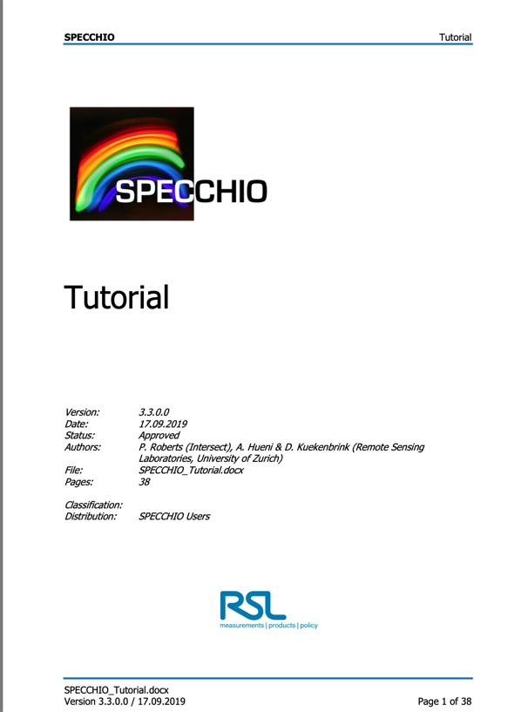
SPECCHIO tutorial: learn how to use the SPECCHIO GUI
https://specchiodb.github.io/Guides/SPECCHIO_Tutorial.pdf

Slide 24




Thank you for your attention!
For more information on the current version of SPECCHIO see: www.specchio.ch
https://twitter.com/SPECCHIO_DB

